Slide 1
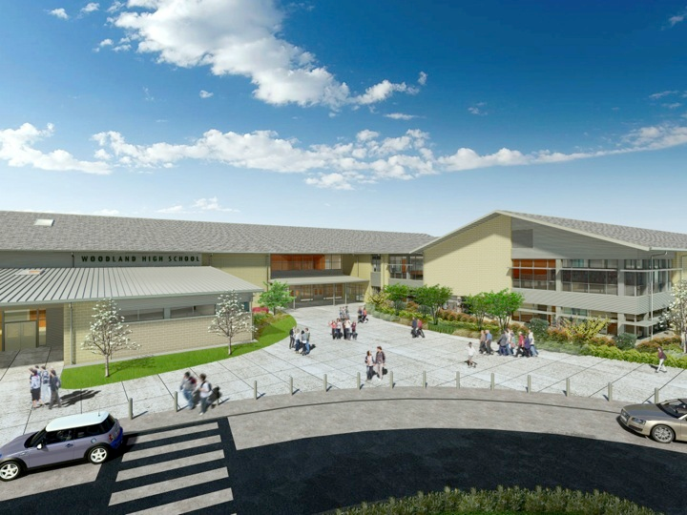
Woodland Public Schools
Facilities and Safety
November 2018 Report

Slide 2
FACILITIES REPORT
Holiday Shutdown
In addition to our annual routine cleaning activities, the following maintenance items are scheduled for this shutdown period:
Handrails for 3 stair platforms at WPS
Annual compliance inspections for boilers, fire systems and backflow devices
Security straps for light covers at WHS main Gym
Repair ceiling tiles, WMS Green Gym
Injuries
This month we encountered 2 significant employee injuries. One of these injuries occurred at the employee’s home, and the second was due to a fall from a ladder at WMS, resulting in a fracture of the employee’s leg.
The first injury resulted from a fall forward, and the employee’s head hit a fireplace hearth. This accident resulted in a fractured neck and significant damage to his spinal cord. The employee has been in the ICU at Peace Health for three weeks, and arrangements are being made to transfer him to a long-term spinal cord rehabilitation facility possibly out of state.
The second injury occurred when an employee was installing a projector system in the Middle School Library. The employee misstepped on the ladder and fell onto his knee, fracturing it and causing ligament damage. This injury also required hospitalization.

Slide 3
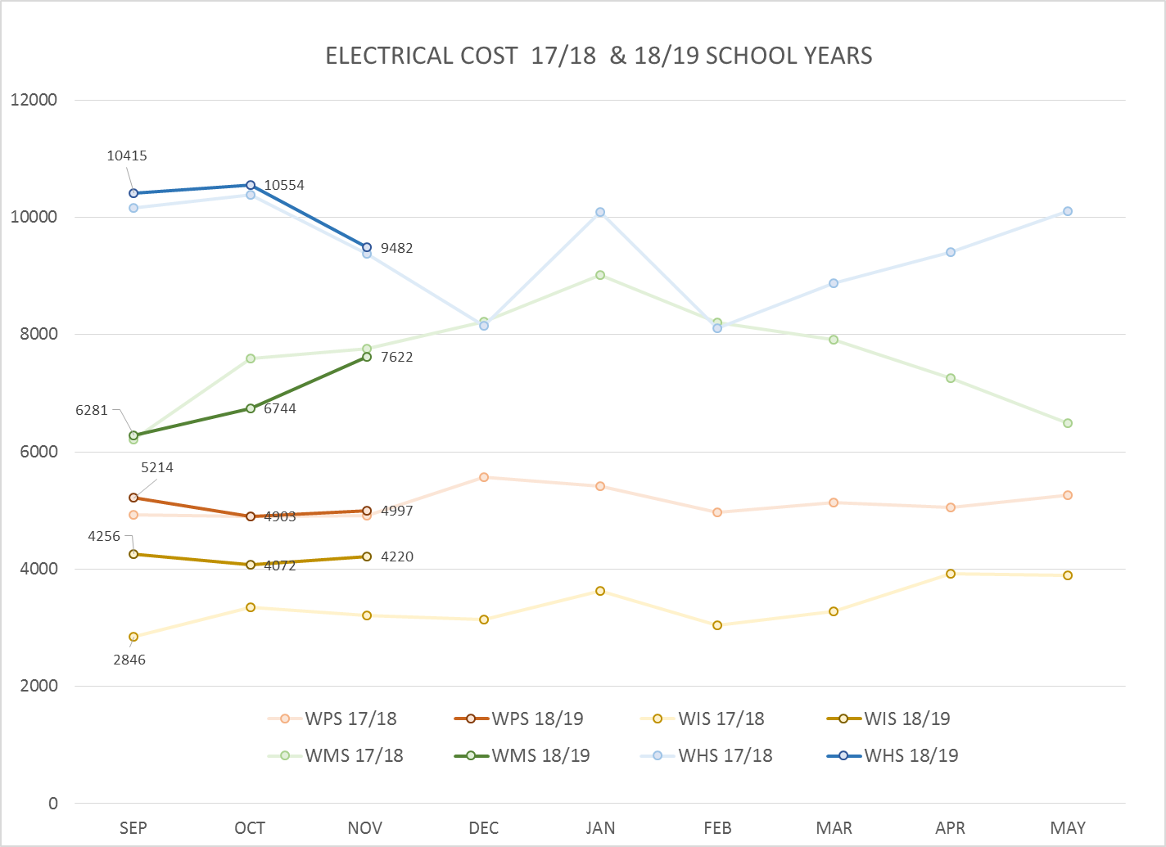
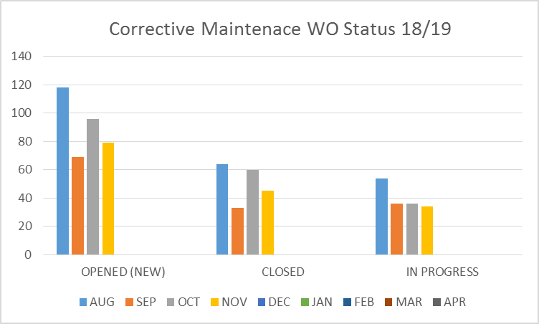
FACILITY CHARTS – POWER COST AND WORK ORDER STATUS

Slide 4
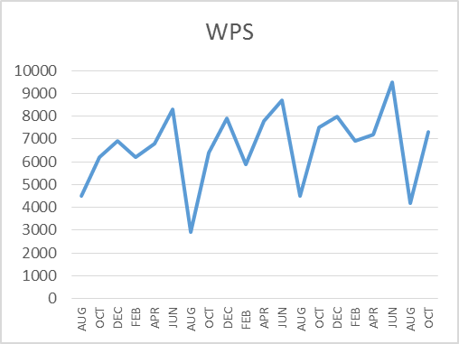
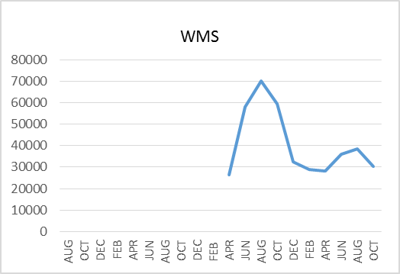
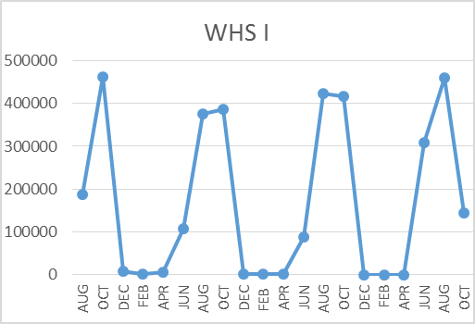
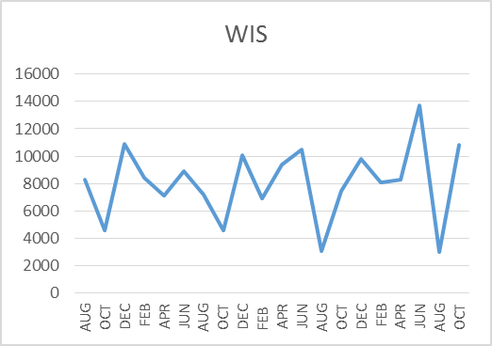
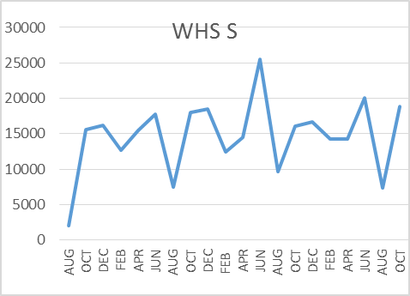
FACILITY CHARTS –
WATER USAGE
WHS, WIS, WMS, WPS
Note
Water charts are updated every two
months. Next update to these charts
in January 2019.
The WMS chart has been reconfigured to include the following 7 meters: 755 Park high and low flow, BO and Team High, PIT house, bus barn, athletic field and DO. All of these meters are totaled on the WMS graph, but each data point is recorded separately to aid in identifying leaks.

Slide 5
SAFETY CHARTS
Accidents for the Month
There were 10 accidents/incidents for the month; 6 students and 4 staff.
Staff Accidents/Incidents
There were 2 staff incidents as the result of student behavior.
WIS employee tripped walking up stairs.
WIS staff slipped on wet floor in lunchroom.
Student Accidents/Injuries
WPS – Student scraped arm due to slipping on play structure.
WIS – Student fractured arm falling on playground.
PIT (WMS) – Student dropped tray on foot; minor tenderness.
PIT (WMS)- Student in wheelchair missed ramp and fell forward; scrape on R/arm.
WHS – Fell during basketball and strained right arm.
WHS –Student broke pinky when contact was made with another student during basketball.

Slide 6
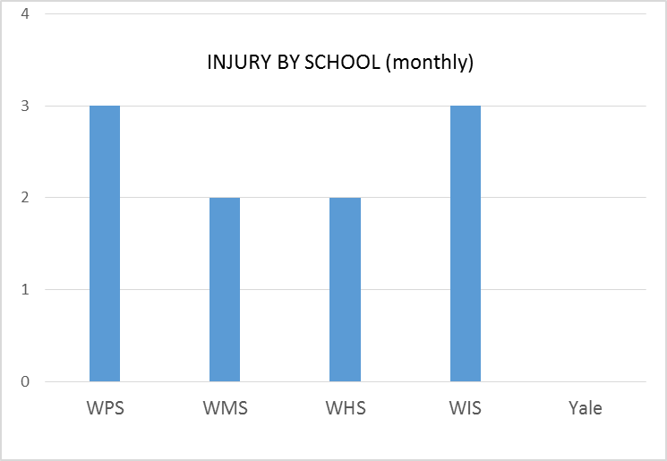
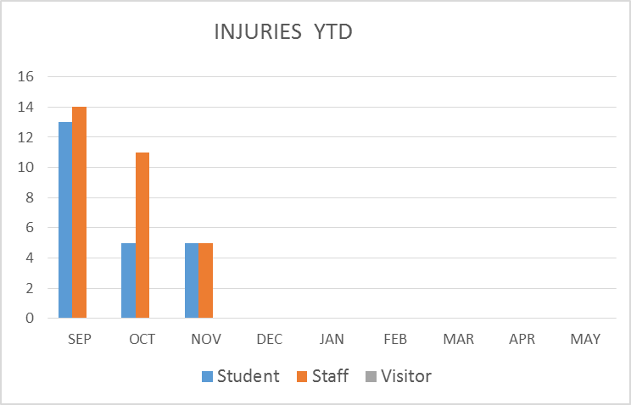
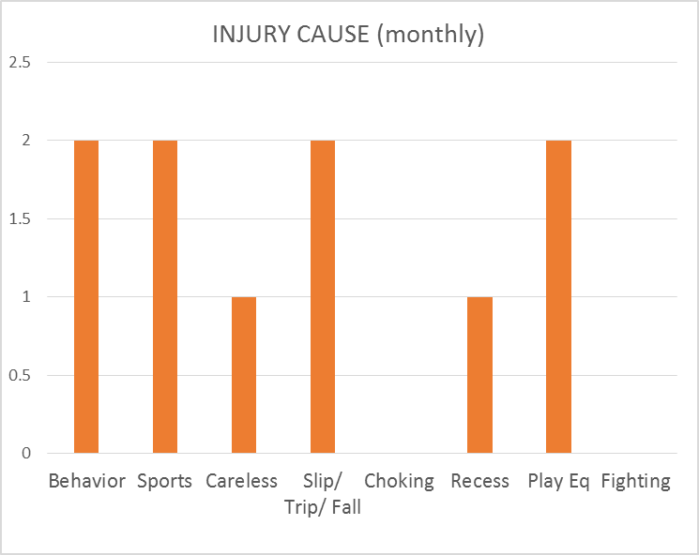
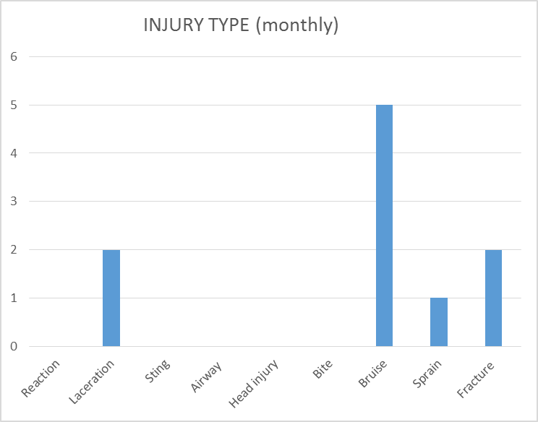
SAFETY CHARTS

